Slide 1
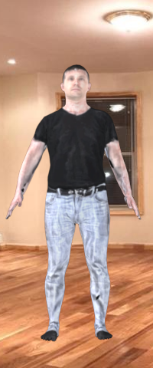
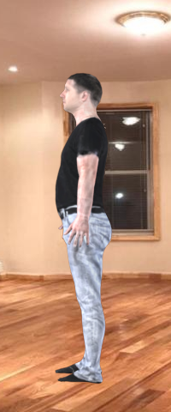
BFNet
Predict Bodyfat % From Images using AI
20.3% BF

Slide 2
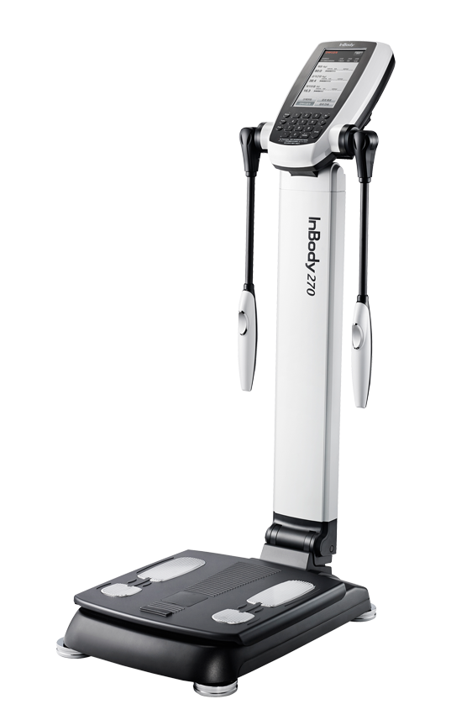
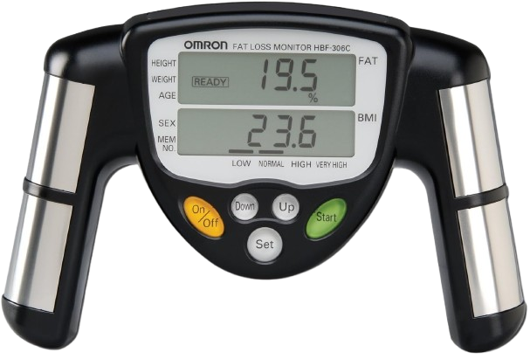
Traditional predictors are inaccessible, AND inaccurate!
-height? (ok)
-weight? (ok)
-age? (ok)
-sex? (ok)
-electric current ???
… we can do better !

Slide 3
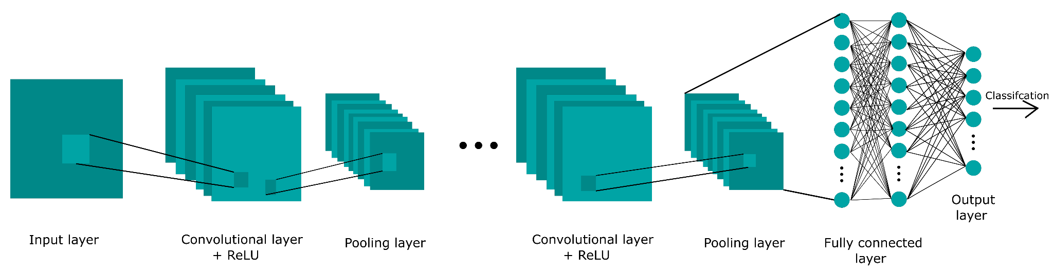
BFNet is an accessible way to predict bodyfat % (1/2)
-Neck
-Chest -Abdomen
-Hip
-Thigh
-Knee
-Ankle
-Biceps
-Forearm -Wrist
Circumference in cm.
Camera is 2.4 m (7.874 ft) away
and 1.6 m (5.25 ft) high

Slide 4
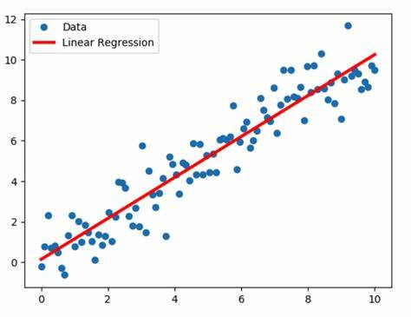
BFNet is an accessible way to predict bodyfat % (2/2)
-Sex
-Age
-Weight
-Height
-Neck
-Chest -Abdomen
-Hip
-Thigh
-Knee
-Ankle
-Biceps
-Forearm -Wrist
20.3% bf

Slide 5
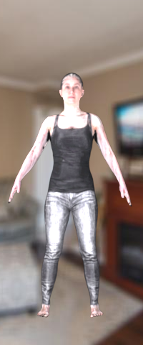
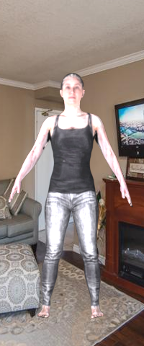
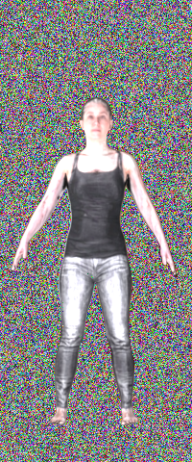
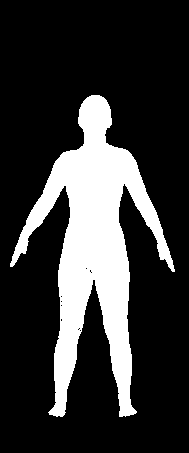
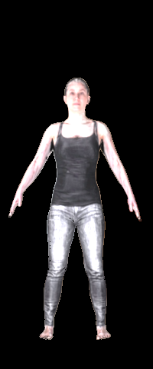
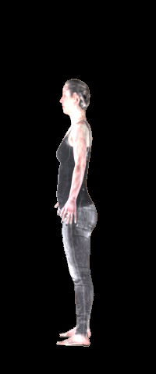
Training Data ~17,000 pairs
Test Data: ~4000 pairs
Average error per model (cm)
Neck:
Chest:
Abdomen:
Hip:
Thigh:
3.8
8.0
9.8
5.6
4.2
Knee:
Ankle:
Biceps:
Forearm:
Wrist:
2.2
2.1
2.8
2.1
1.1

Slide 6
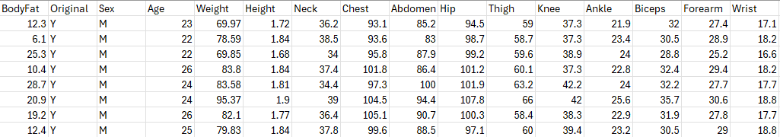
Training Data ~400 points
Error from 10-Fold Cross Validation (% bf): 3.27%

Slide 7
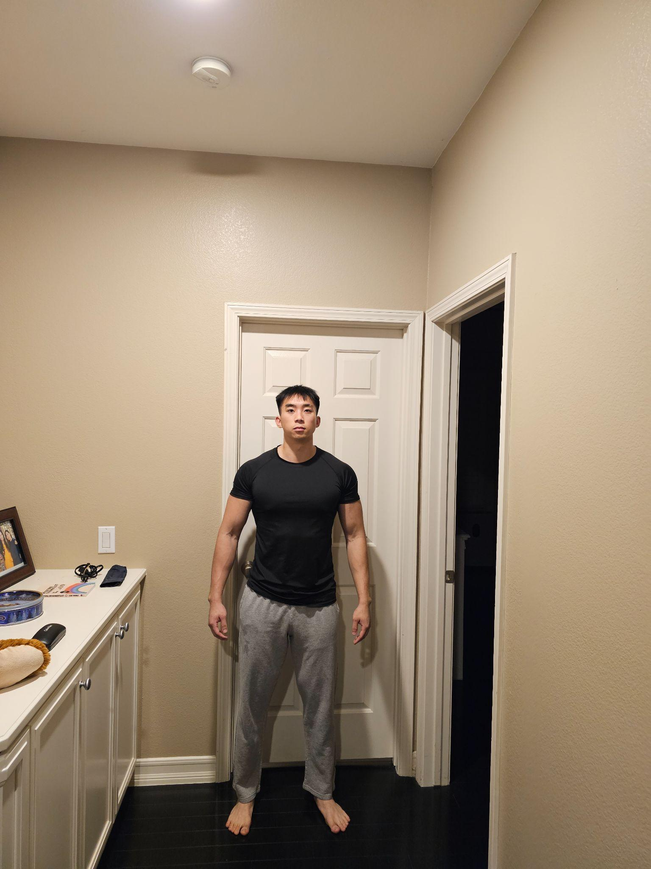
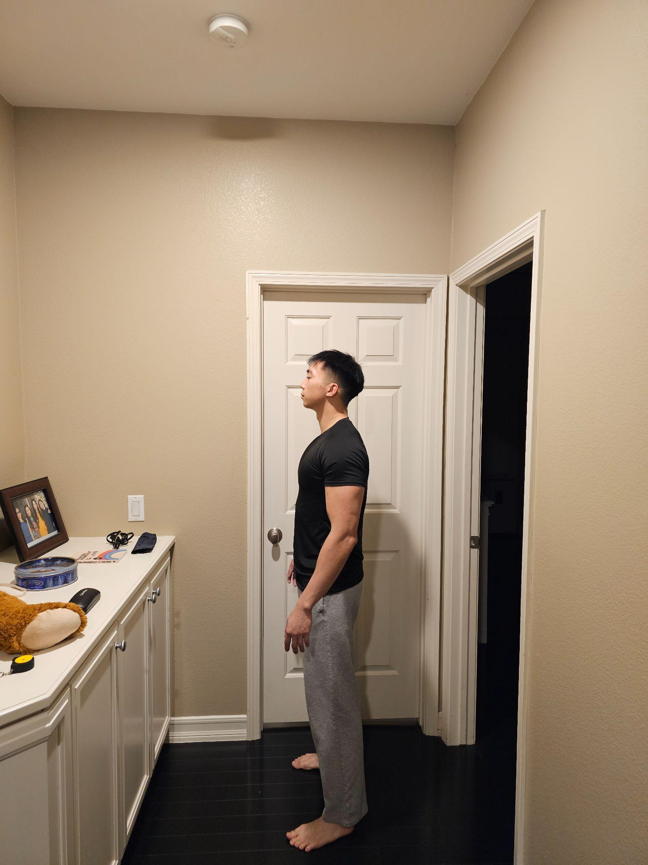
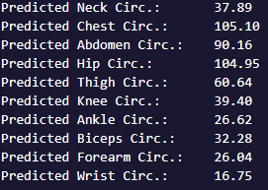

Similar results to other methods !!!!!!!

